Slide 1
Sentiment Prediction
Real-time in SQL Server
Hiram Fleitas
Download: github.com/hfleitas/seattle2019

Slide 4
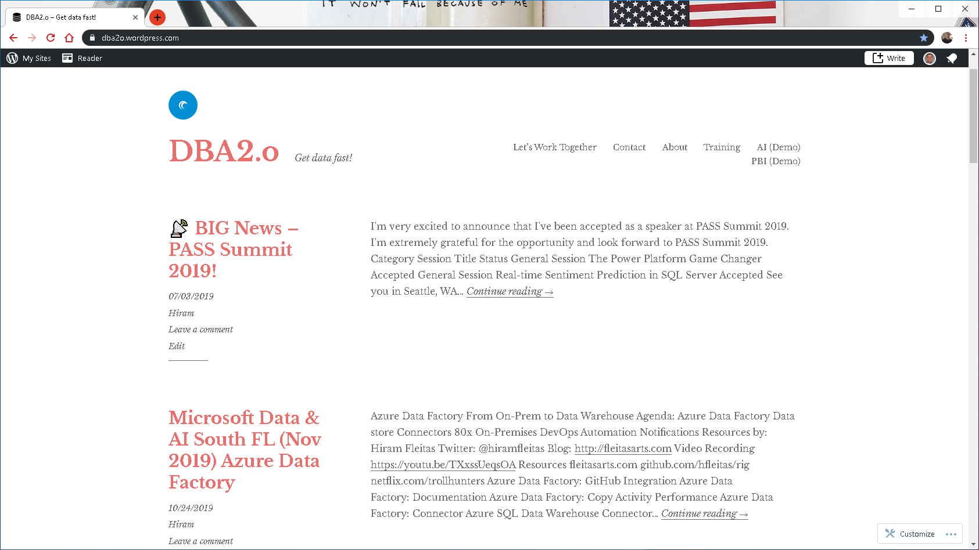

Slide 5



Link to Poll:
bit.ly/mssql2019
Your participation is very important.

Slide 6
Notes:
Add QR code

Slide 7



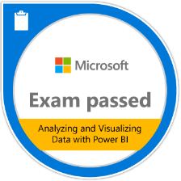








Hiram Fleitas
Principal Database Architect,
Universal Property & Casualty Insurance Company
Bio
Father
Developer since 1995
SQL Server since 1999
Fleitas Arts, LLC since 2008
USCG Auxiliary Flotilla Staff Officer
@hiramfleitas
/hfleitas
hiram@fleitasarts.com
hiramfleitas
fleitasarts.com

Slide 8
Universal Insurance Holdings (UVE): Growth Story
Leading holding company of personal residential homeowners insurance and services
Doing business
Licensed
$1B+
FY18 Direct Premium Written
#1
Best-in-class Return on Equity
(5-yr Average)
MN
WI
NY
NH
WI
MA
MI
18
States actively doing business
>800K
Customer policies managed
IA
PA
NJ
IL
IN
DE
VA
MD
NC
800+
Full time equivalent employees
9,000+
Independent agents in the distribution channel
SC
AL
GA
FL
Ft. Lauderdale, FL
A
Exceptional
Demotech financial stability rating
HI
Headquarters

Slide 9
Agenda
5 DEMOS
Setup
Debugging
Performance
Cognitive API
Spark Streaming

Slide 10
one
Add ML Features
Grant Access & Configure
Install Pre-Trained Models

Slide 11
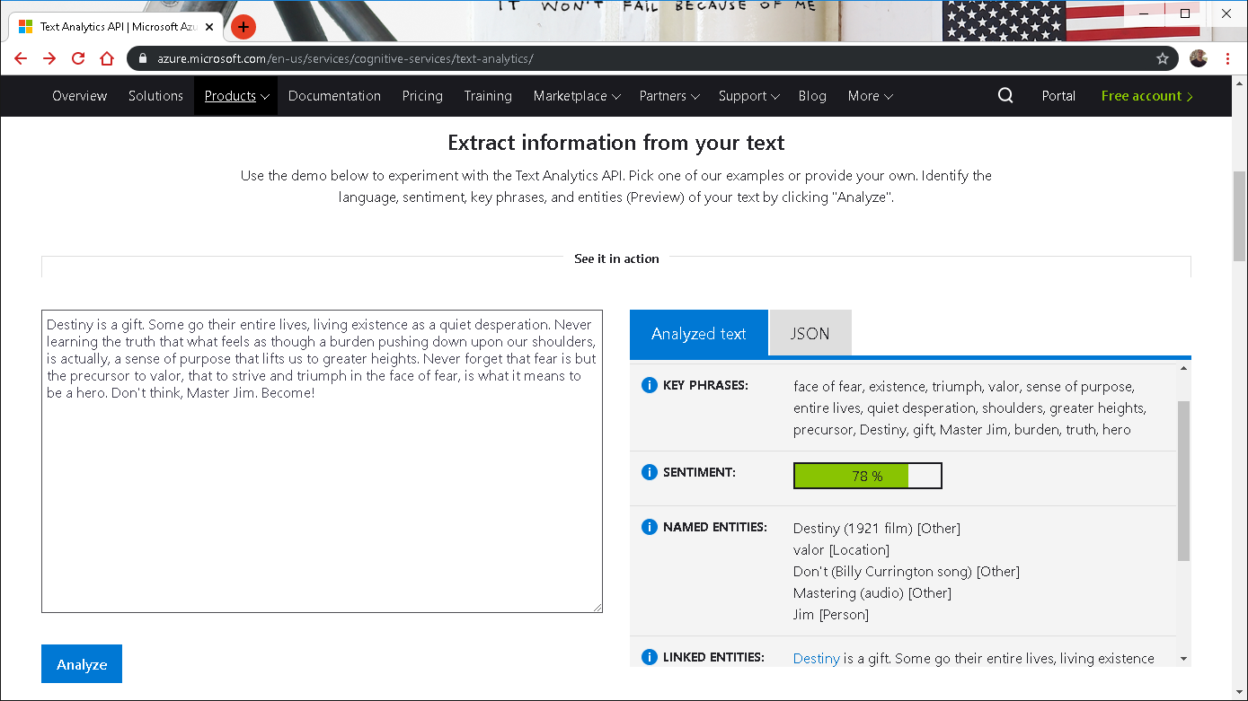

Notes:
https://www.netflix.com/title/80075820

Slide 12
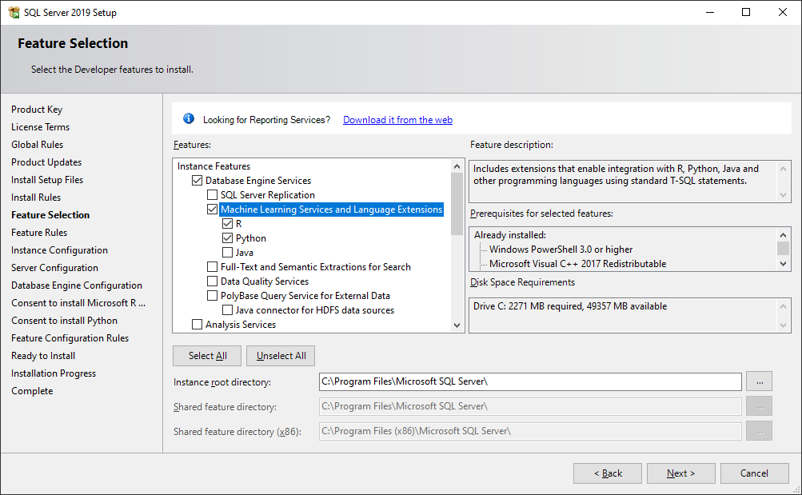
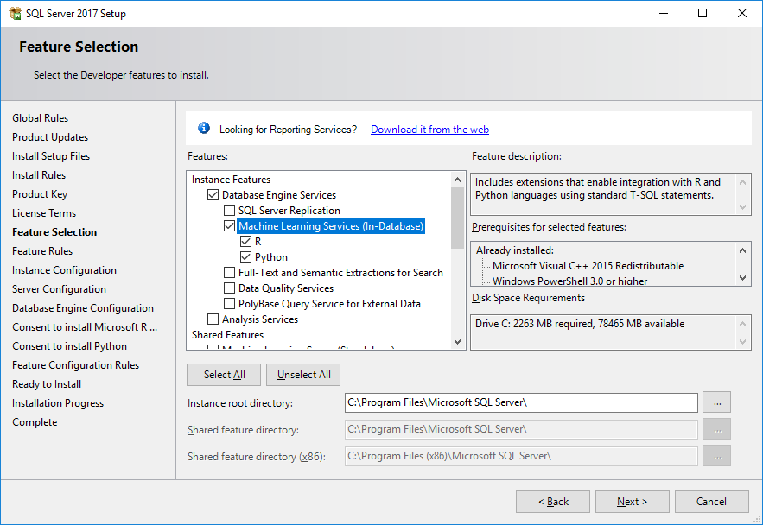

Slide 13
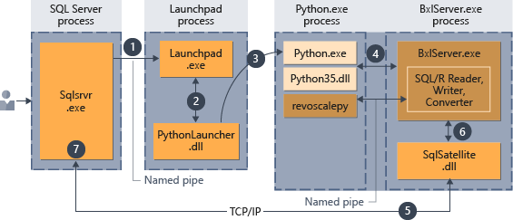
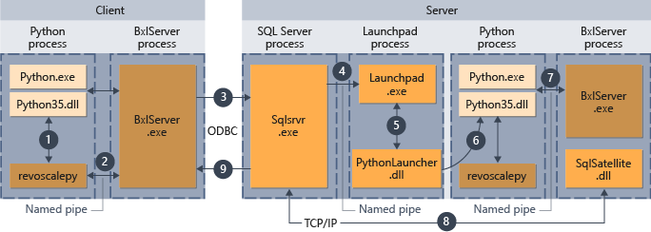
Execution Architecture
Learn more:
https://docs.microsoft.com/en-us/sql/advanced-analytics/concepts/extension-python
https://docs.microsoft.com/en-us/sql/advanced-analytics/install/sql-server-machine-learning-services-2019
https://docs.microsoft.com/en-us/sql/advanced-analytics/data-collection-ml-troubleshooting-process
Notes:
Execution Architecture: https://docs.microsoft.com/en-us/sql/advanced-analytics/concepts/extension-python
Isolation Changes: https://docs.microsoft.com/en-us/sql/advanced-analytics/install/sql-server-machine-learning-services-2019
Troubleshoot data collection for ML: https://docs.microsoft.com/en-us/sql/advanced-analytics/data-collection-ml-troubleshooting-process

Slide 14
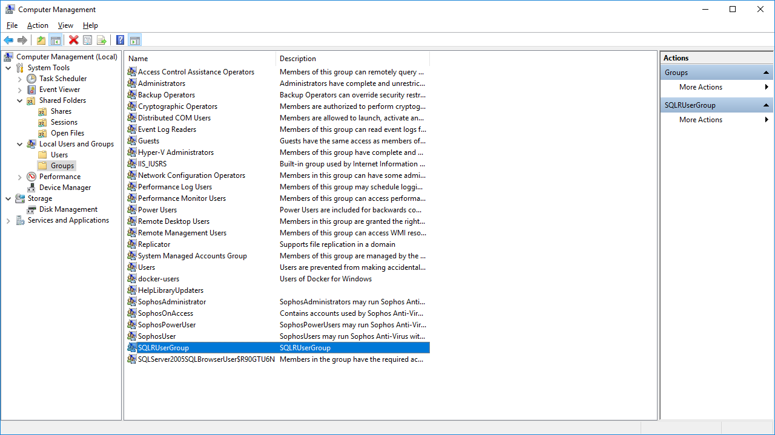
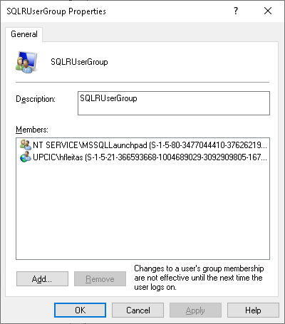
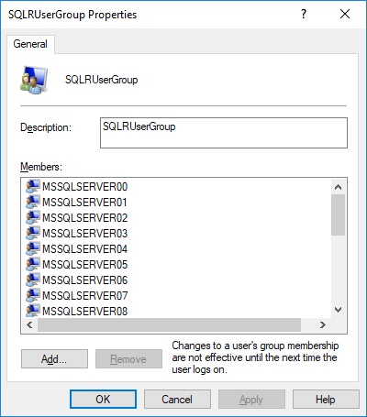

Slide 15
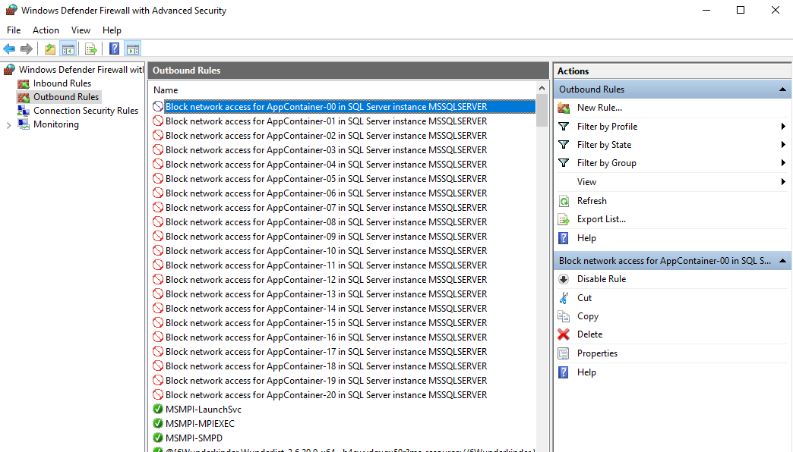

Slide 16
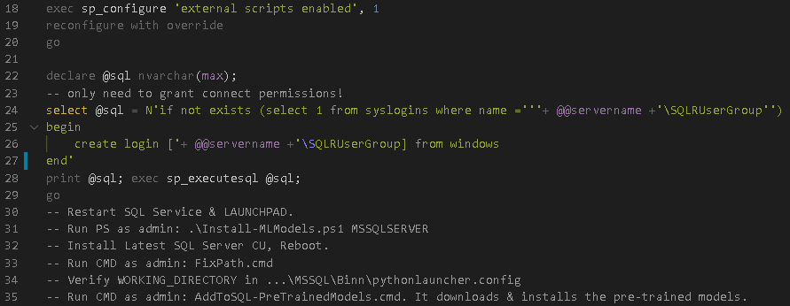

Slide 17
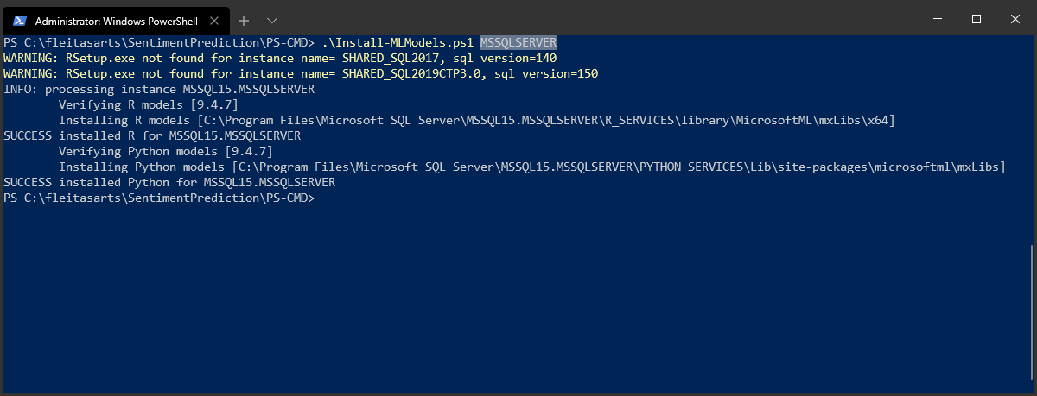
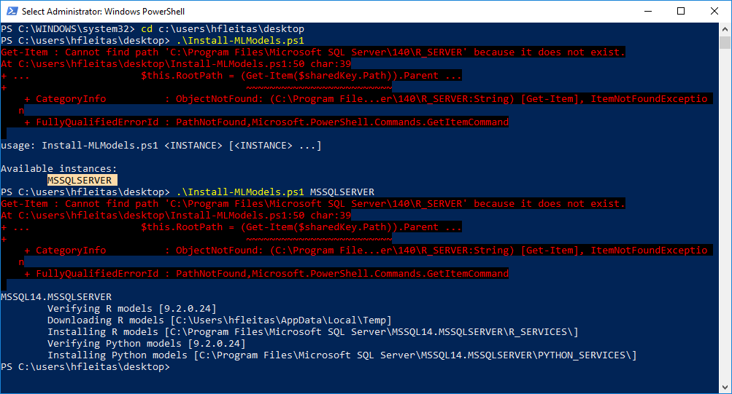
Notes:
https://docs.microsoft.com/en-us/sql/advanced-analytics/install/sql-pretrained-models-install?view=sql-server-ver15
https://github.com/MicrosoftDocs/sql-docs/issues/2207

Slide 18
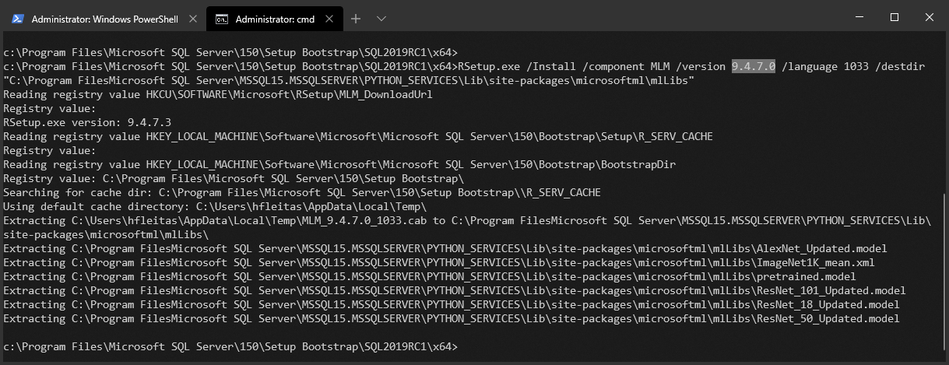
Notes:
rem 2019
cd c:\Program Files\Microsoft SQL Server\150\Setup Bootstrap\SQL2019RC1\x64
RSetup.exe /install /component MLM /version 9.4.7.0 /language 1033 /destdir "C:\Program Files\Microsoft SQL Server\MSSQL15.MSSQLSERVER\PYTHON_SERVICES\Lib\site-packages\microsoftml\mxLibs"

Slide 19
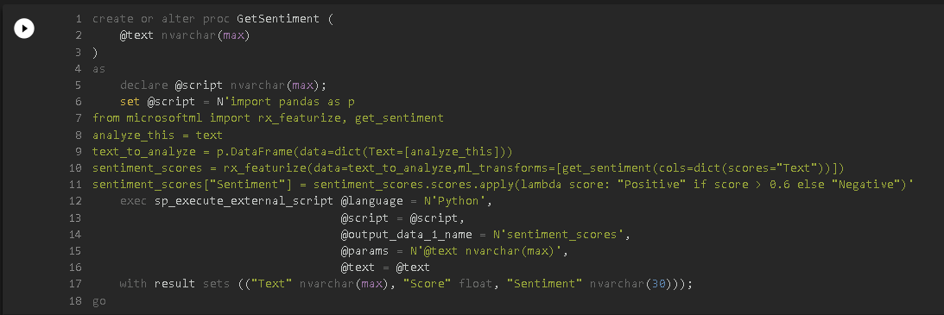

Slide 20
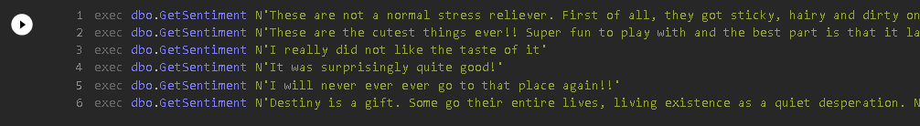
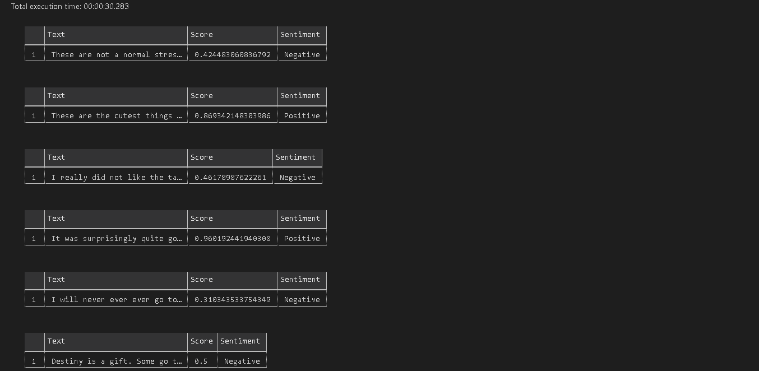

Slide 21
two
Requirements.txt
Common Vulnerabilities
Python Profiling
Notes:
CVE® is a list of entries—each containing an identification number, a description, and at least one public reference—for publicly known cybersecurity vulnerabilities.
https://cve.mitre.org/

Slide 22
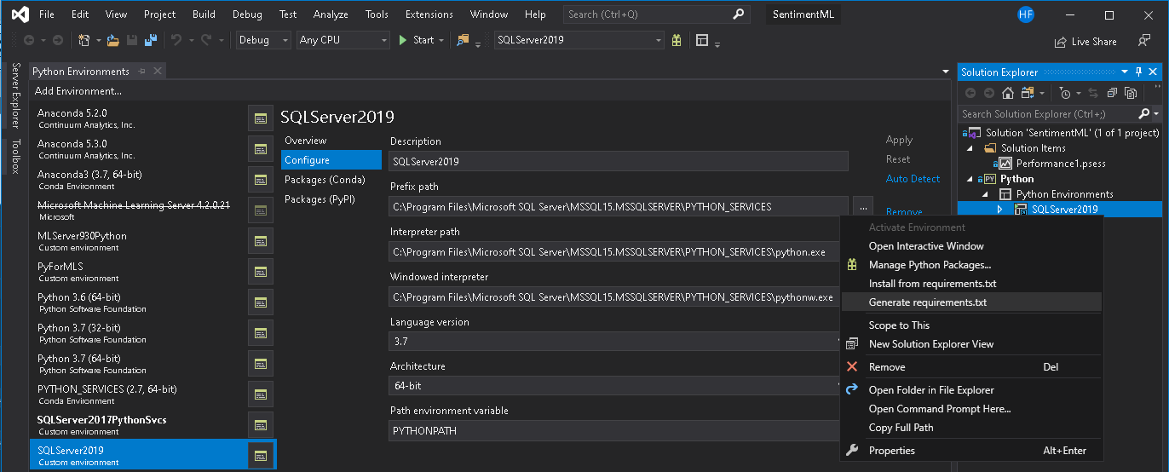

Notes:
CVE® is a list of entries—each containing an identification number, a description, and at least one public reference—for publicly known cybersecurity vulnerabilities.
https://cve.mitre.org/

Slide 23
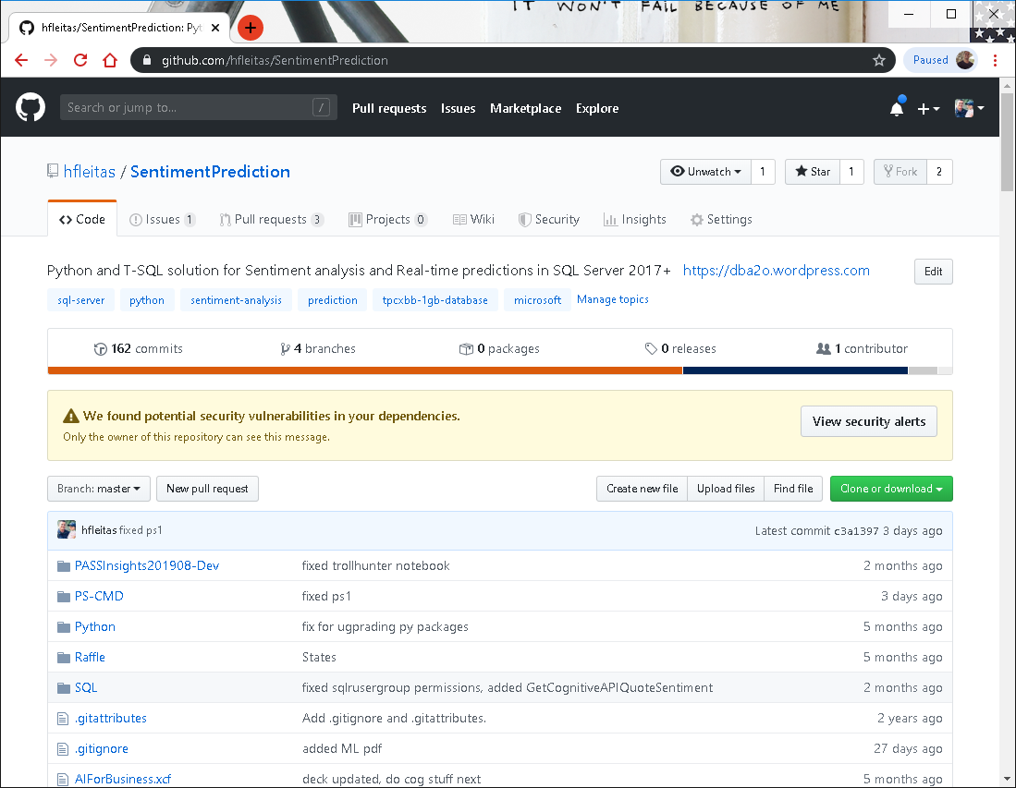
Notes:
CVE® is a list of entries—each containing an identification number, a description, and at least one public reference—for publicly known cybersecurity vulnerabilities.
https://cve.mitre.org/

Slide 24
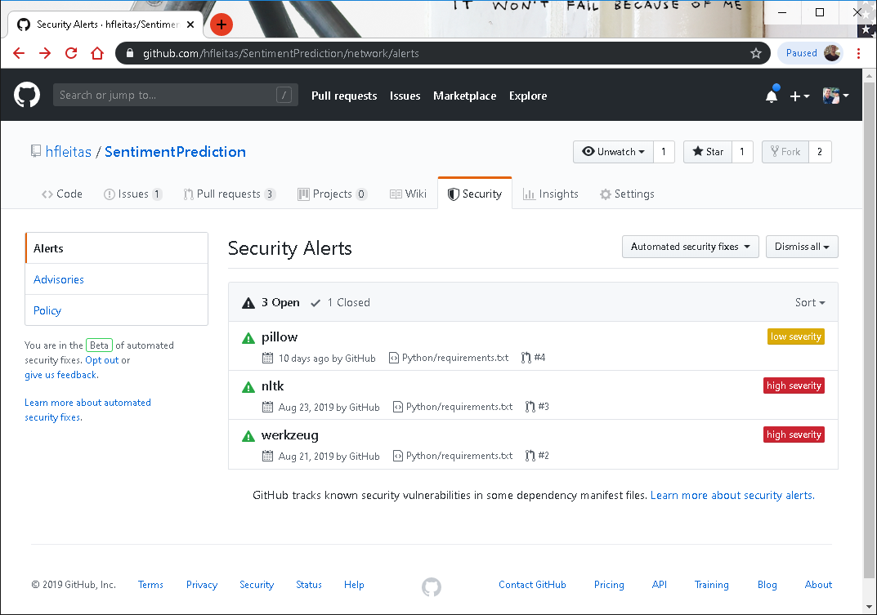
Notes:
CVE® is a list of entries—each containing an identification number, a description, and at least one public reference—for publicly known cybersecurity vulnerabilities.
https://cve.mitre.org/

Slide 25
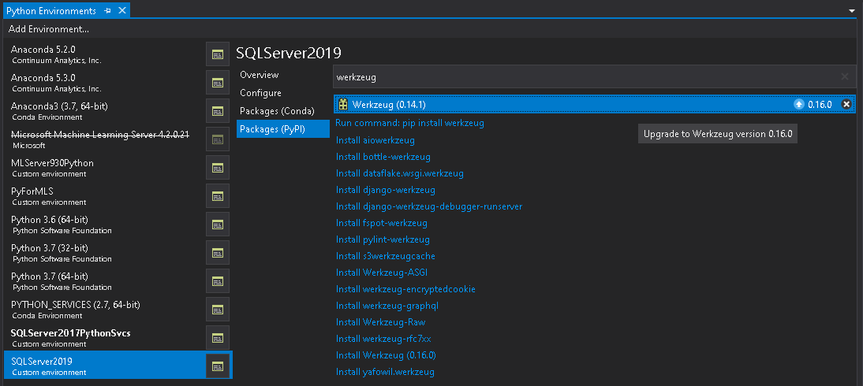

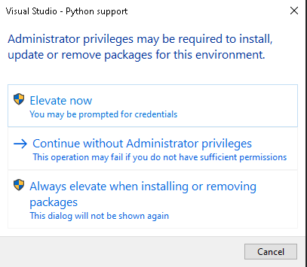
Admin cmd or PowerShell:
python.exe -m pip install -U pkgname==x.y.z
python.exe -m pip list
Notes:
CVE® is a list of entries—each containing an identification number, a description, and at least one public reference—for publicly known cybersecurity vulnerabilities.
https://cve.mitre.org/

Slide 26
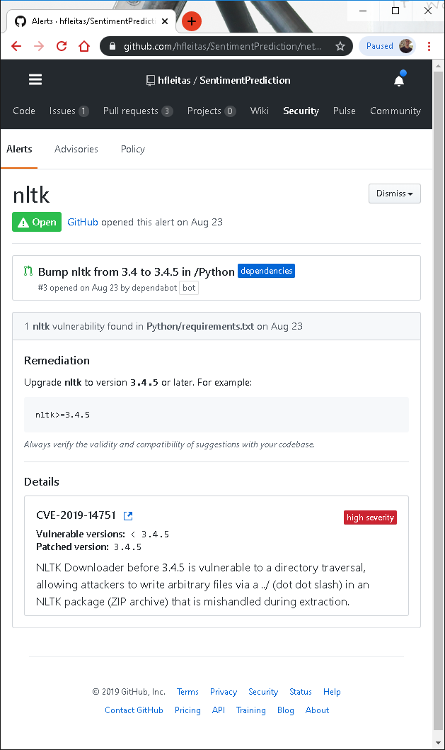
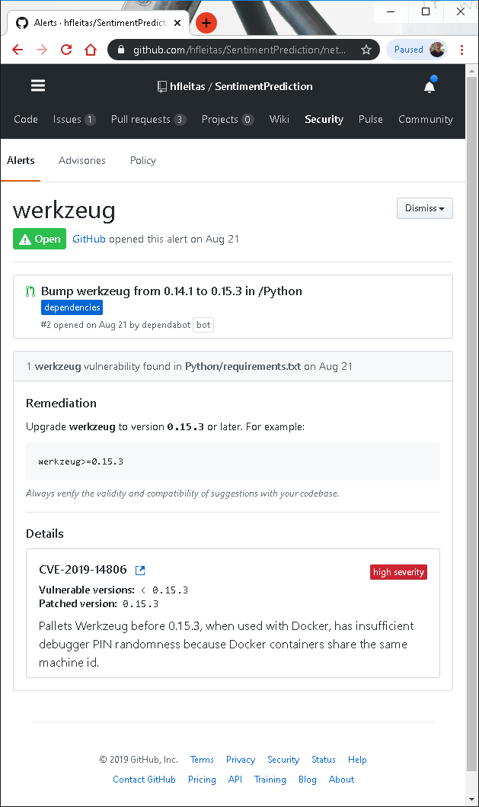
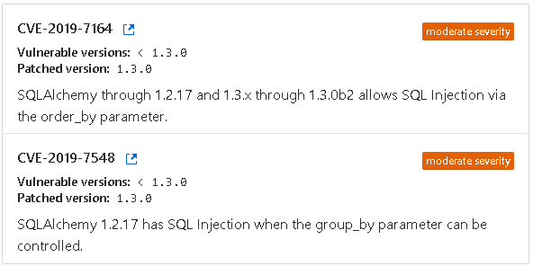
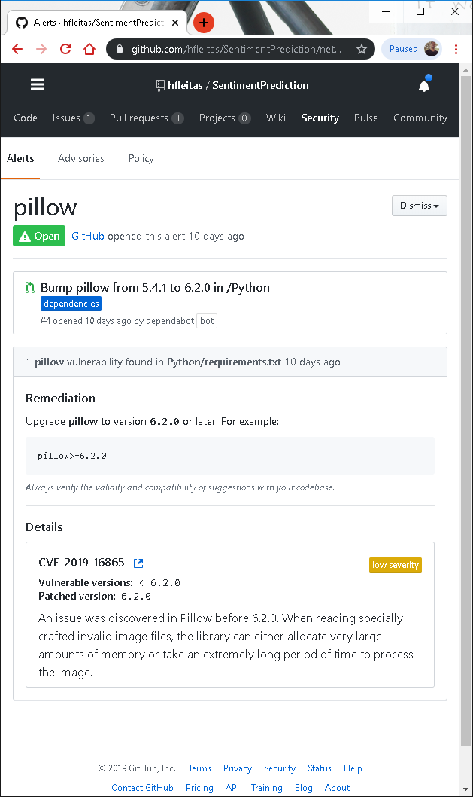
Details
Notes:
CVE® is a list of entries—each containing an identification number, a description, and at least one public reference—for publicly known cybersecurity vulnerabilities.
https://cve.mitre.org/

Slide 27
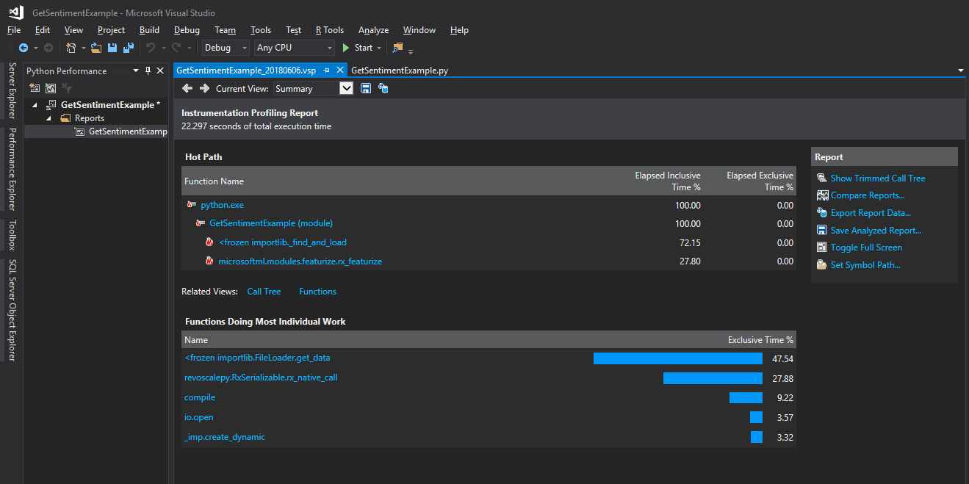
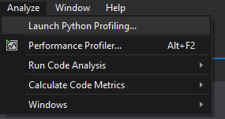

Slide 28
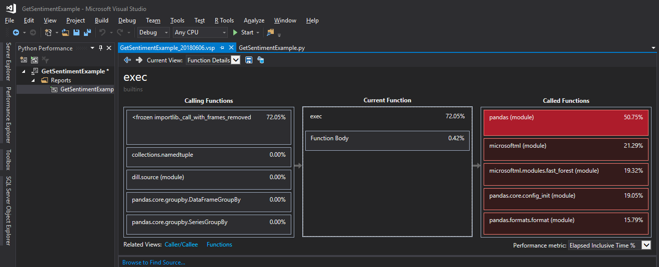

Slide 29
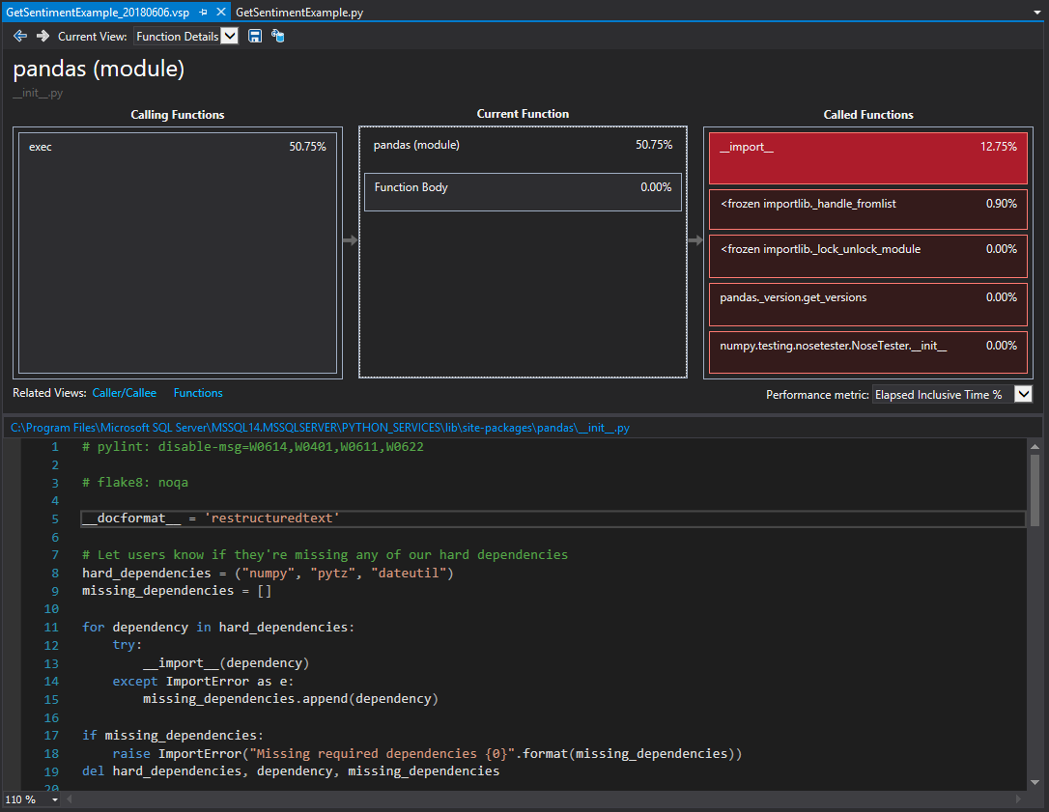

Slide 30
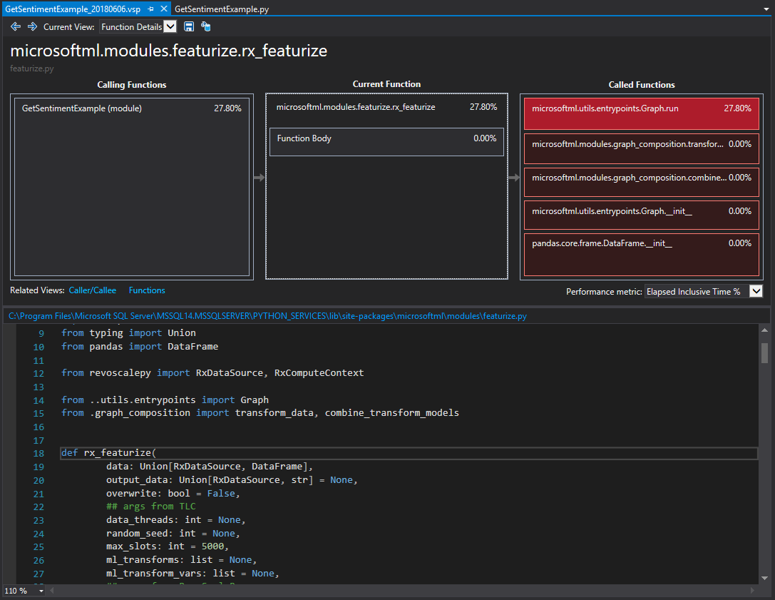

Slide 31
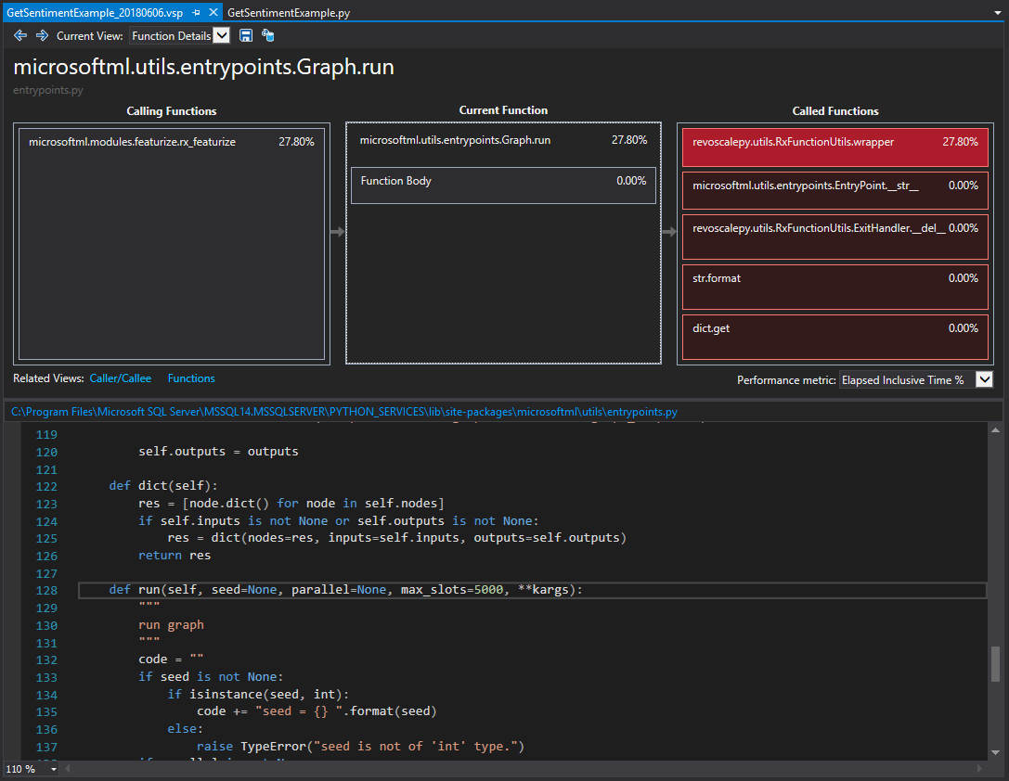

Slide 32
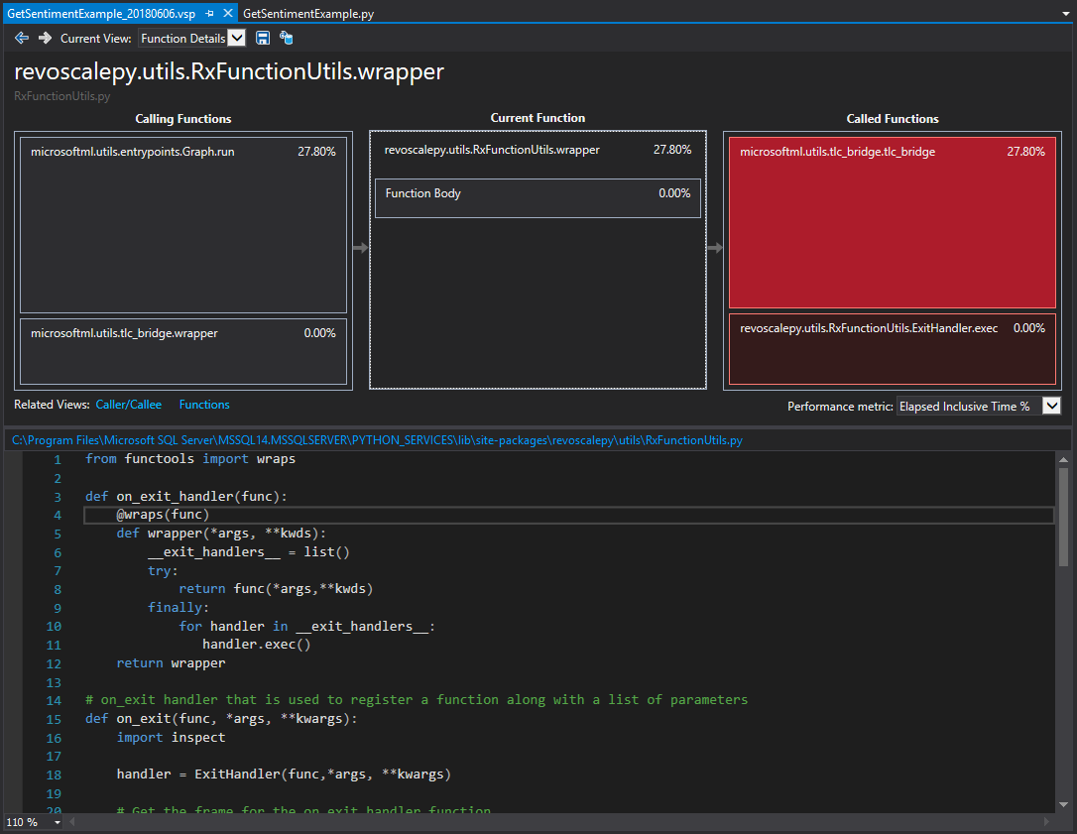

Slide 33
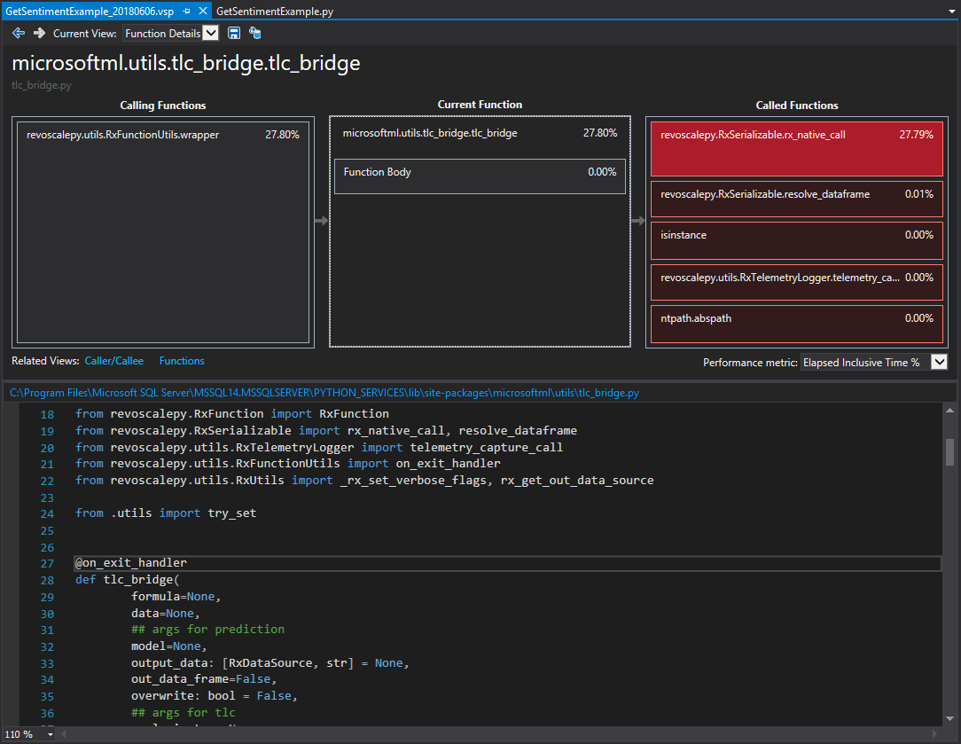

Slide 34
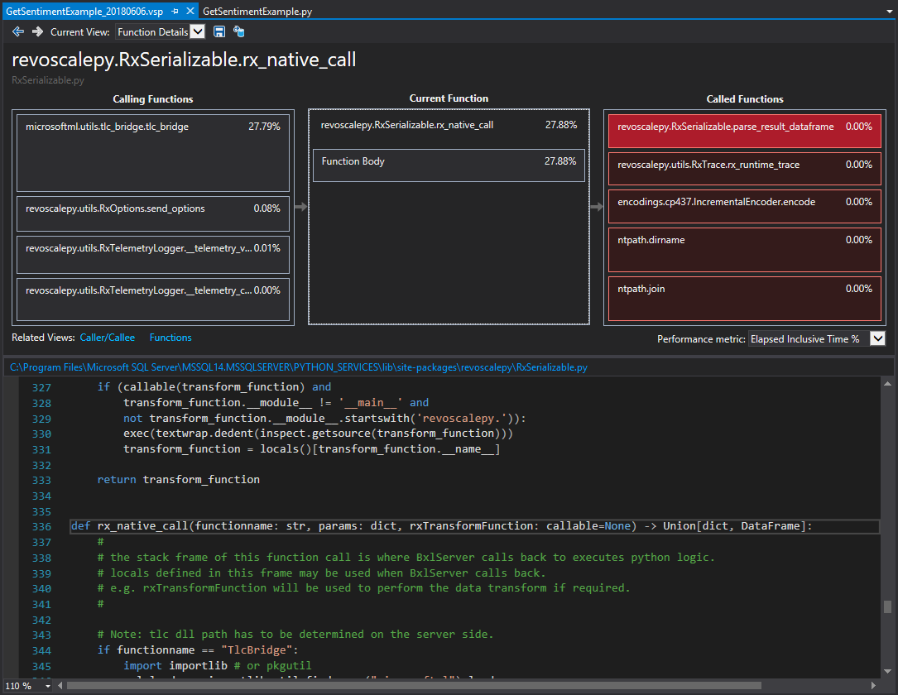

Slide 35
three
In-Database ML
realtime_scoring_only = True
sp_rxPredict
Performance Metrics
Notes:
CVE® is a list of entries—each containing an identification number, a description, and at least one public reference—for publicly known cybersecurity vulnerabilities.
https://cve.mitre.org/

Slide 36
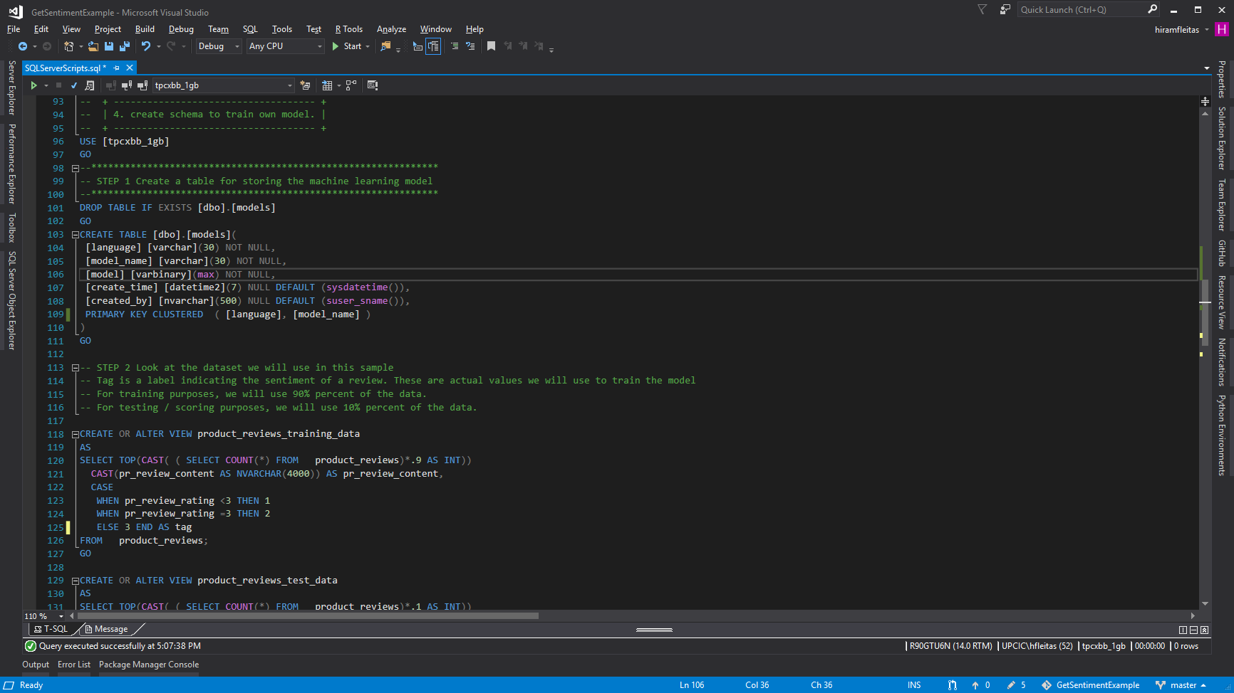
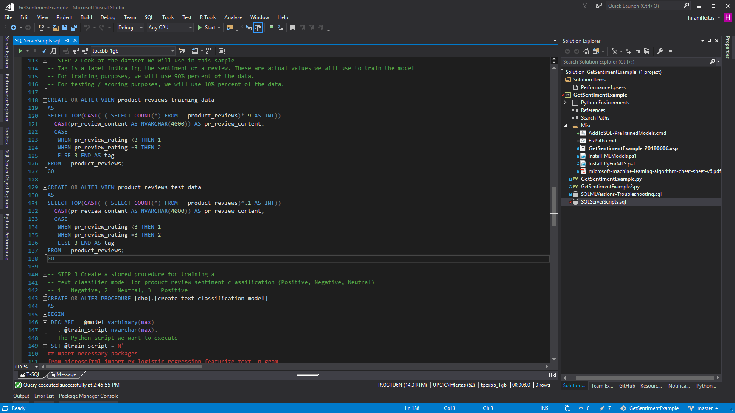
Learn more:
https://blogs.msdn.microsoft.com/sqlserverstorageengine/2017/11/01/sentiment-analysis-with-python-in-sql-server-machine-learning-services
https://sqlchoice.blob.core.windows.net/sqlchoice/static/tpcxbb_1gb.bak
Notes:
Learn more:
https://blogs.msdn.microsoft.com/sqlserverstorageengine/2017/11/01/sentiment-analysis-with-python-in-sql-server-machine-learning-services
https://sqlchoice.blob.core.windows.net/sqlchoice/static/tpcxbb_1gb.bak

Slide 37
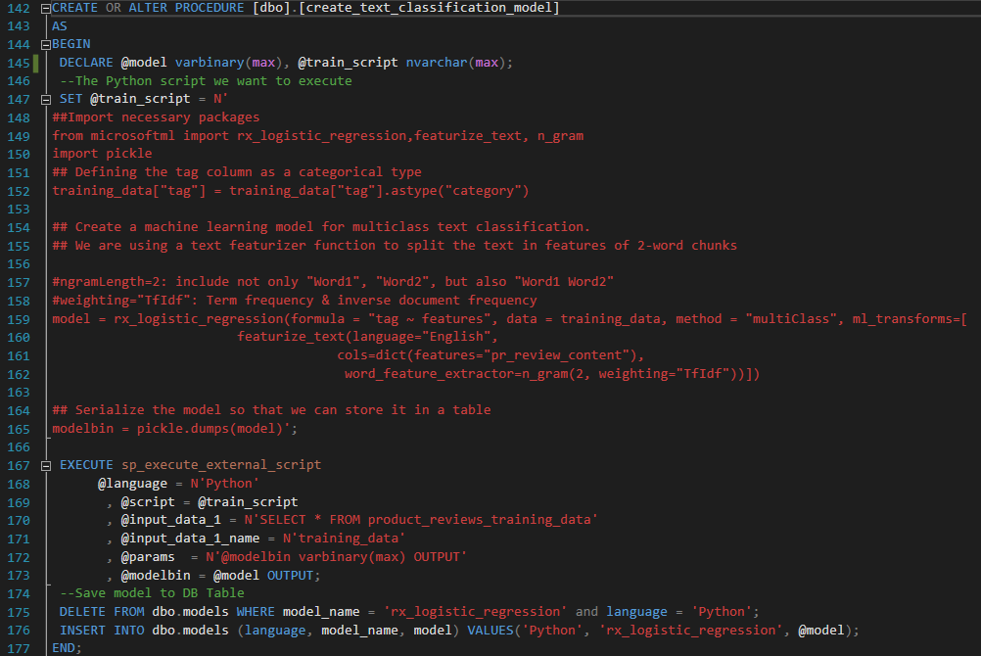
Learn more:
https://blogs.msdn.microsoft.com/sqlserverstorageengine/2017/11/01/sentiment-analysis-with-python-in-sql-server-machine-learning-services
https://sqlchoice.blob.core.windows.net/sqlchoice/static/tpcxbb_1gb.bak

Slide 38
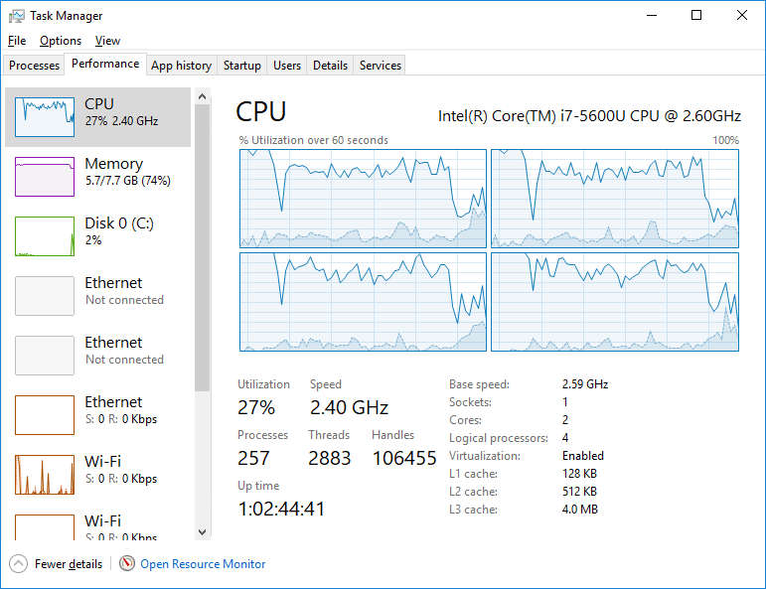
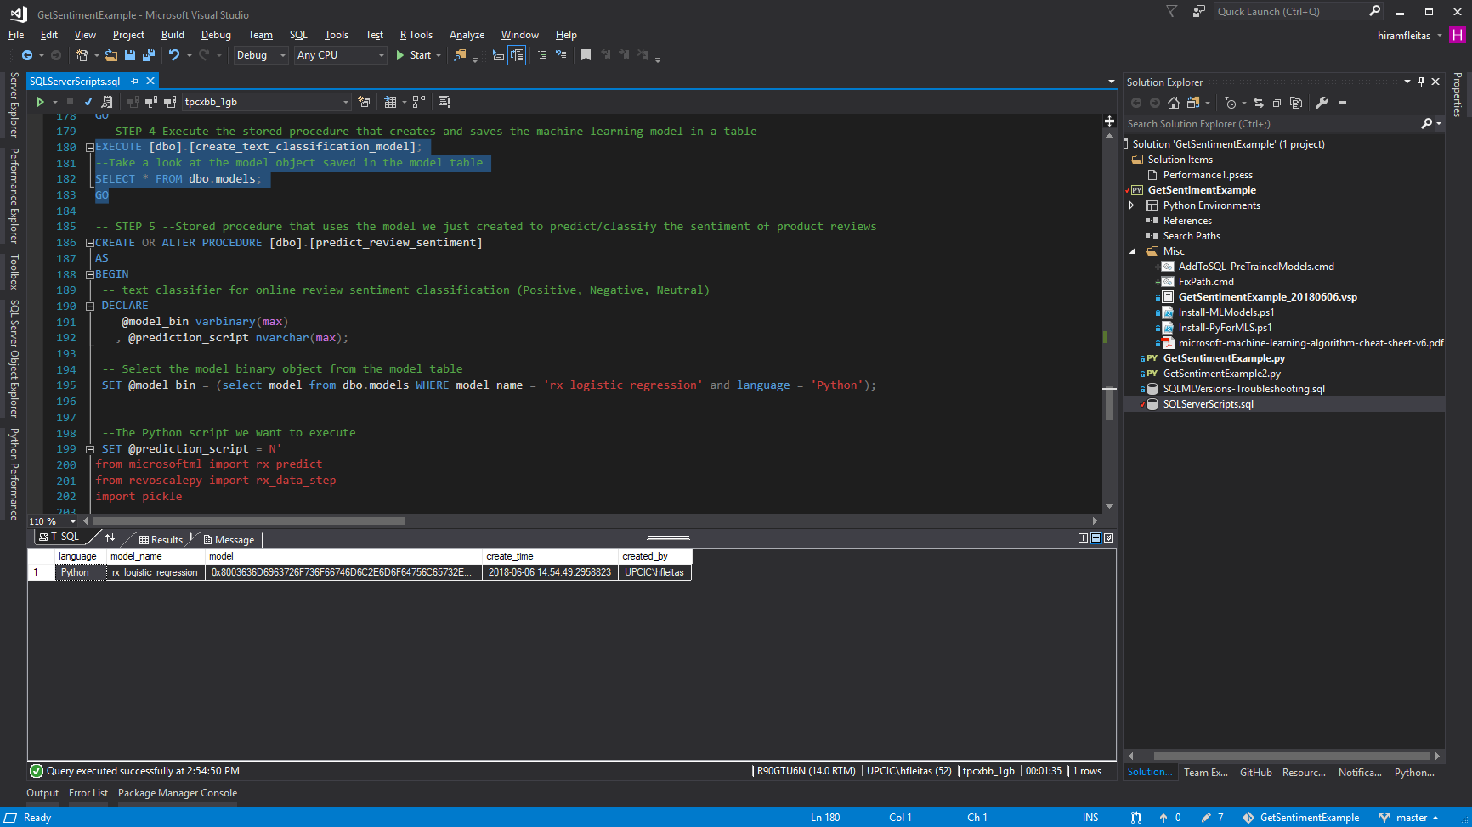
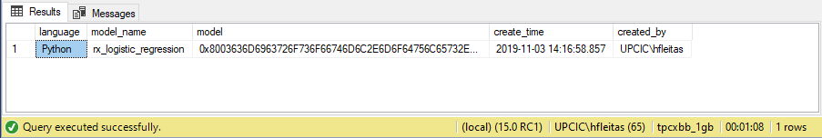
Total execution time
SQL Server 2017: 00:01:35
SQL Server 2019: 00:01:08

Slide 39
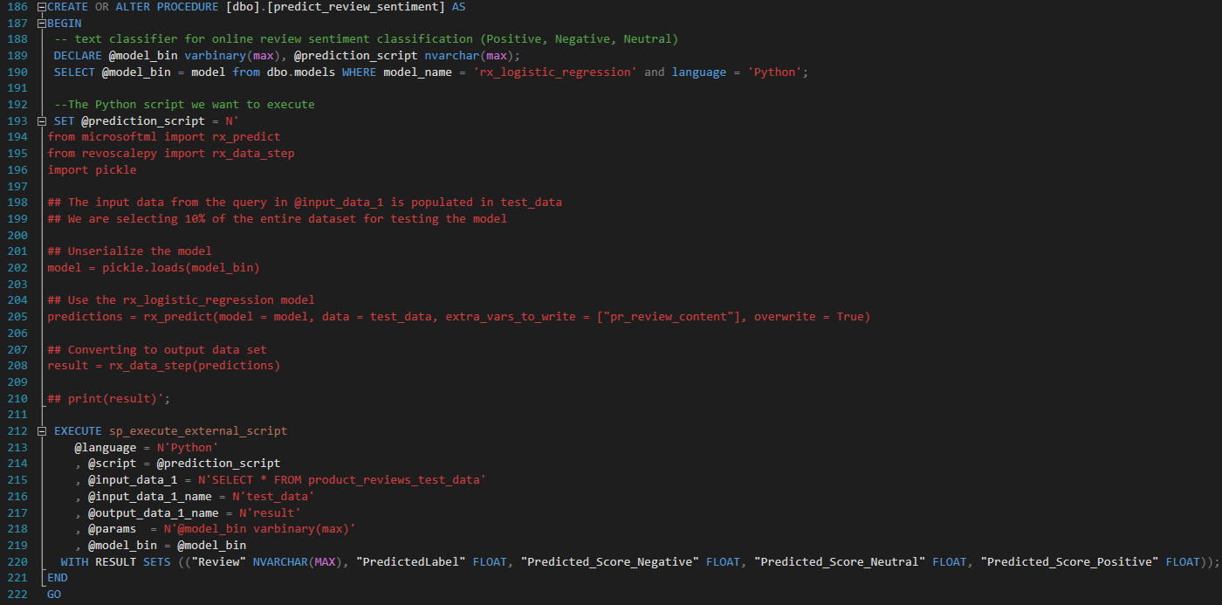

Slide 40
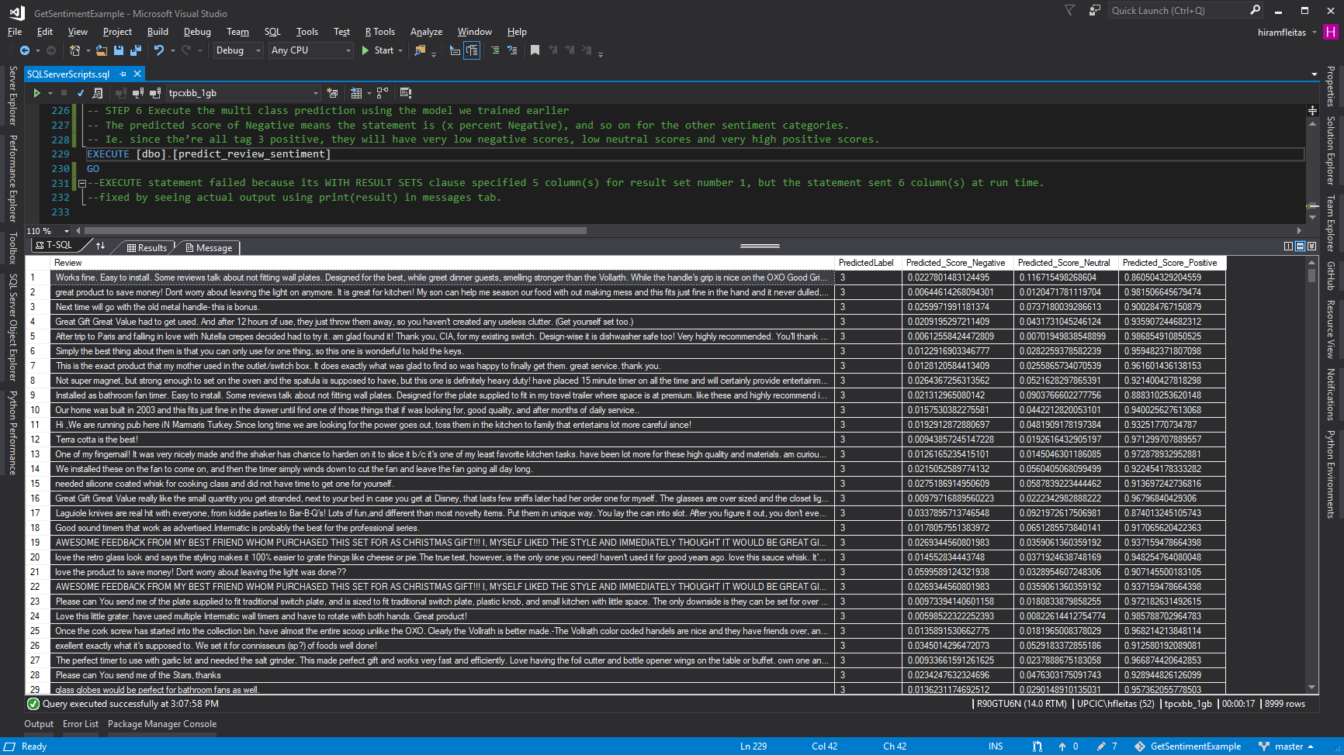
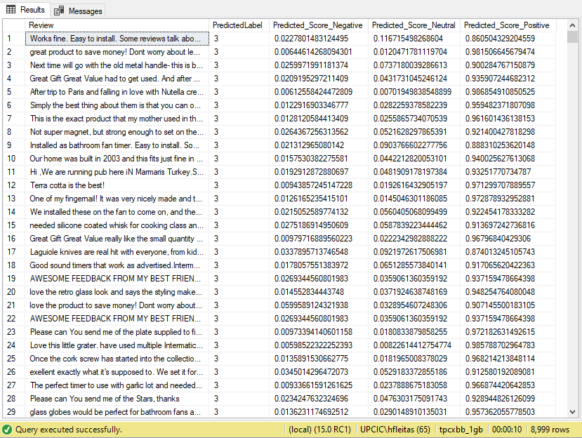
Total execution time
SQL Server 2017: 00:00:17
SQL Server 2019: 00:00:10

Slide 41
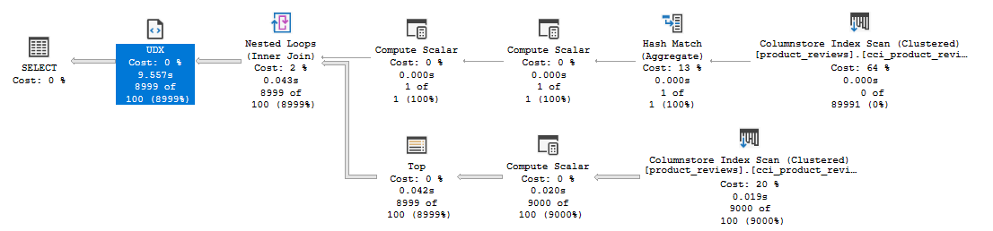
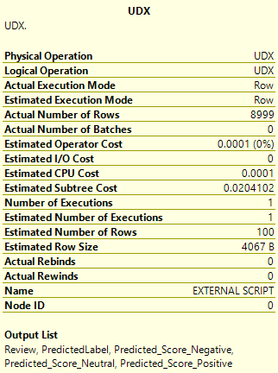
Execution Plan

Slide 42
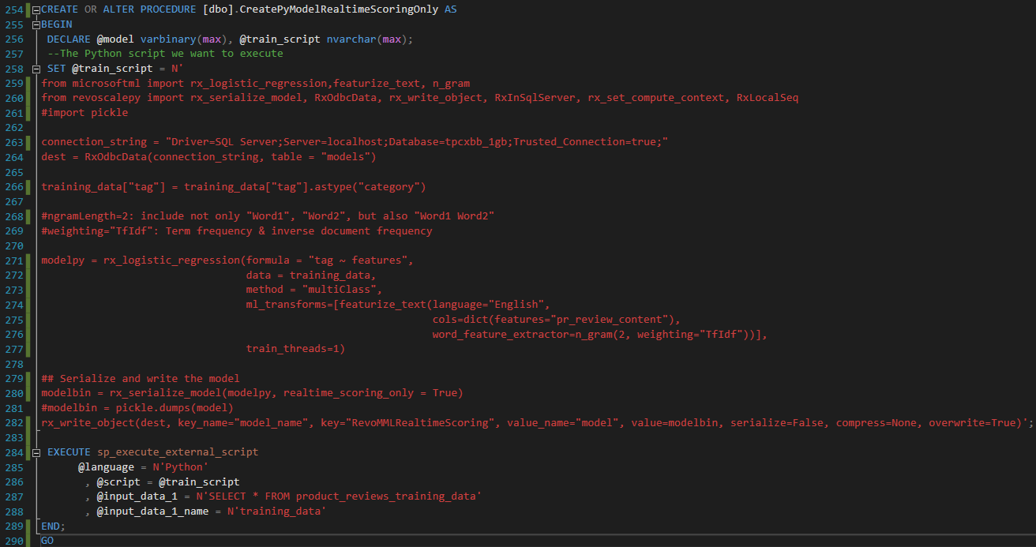

Slide 43
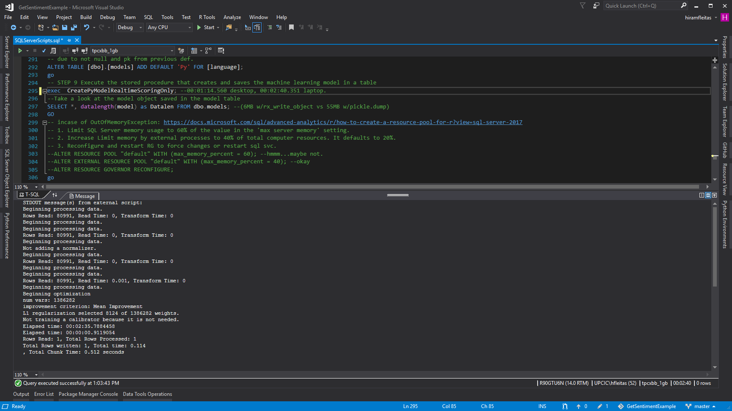
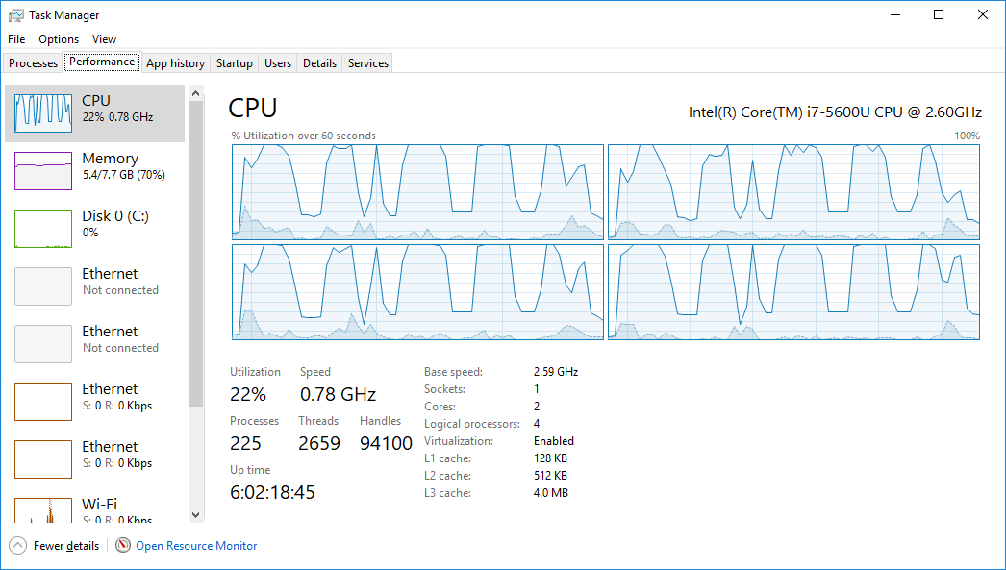

Total execution time
SQL Server 2017: 00:02:40
SQL Server 2019: 00:01:00

Slide 44



Let’s try sp_rxPredict
Learn more:
https://docs.microsoft.com/en-us/sql/advanced-analytics/r/how-to-do-realtime-scoring

Slide 45


Slide 46



Slide 47


Slide 49
four
(T-SQL) for json path
(Python) json_normalize
CognitiveAPI.ipynb
Trollhunters.ipynb
(PDF) TrumpUkraine.ipynb
Notes:
CVE® is a list of entries—each containing an identification number, a description, and at least one public reference—for publicly known cybersecurity vulnerabilities.
https://cve.mitre.org/

Slide 50

Learn more:
https://docs.microsoft.com/azure/cognitive-services/text-analytics/quickstarts/python
https://azure.microsoft.com/services/cognitive-services/text-analytics

Slide 51

Learn more:
https://docs.microsoft.com/sql/relational-databases/json/format-nested-json-output-with-path-mode-sql-server

Slide 52



Slide 53

Learn more:
https://docs.microsoft.com/sql/relational-databases/json/format-nested-json-output-with-path-mode-sql-server
https://docs.microsoft.com/sql/relational-databases/system-stored-procedures/sp-execute-external-script-transact-sql

Slide 54



Slide 55

Upgrade via Notebook

Slide 56

Learn more:
How to output values from sp_execute_external_script into table
Convert JSON API response to pandas Dataframe

Slide 57

Learn more:
https://repl.it/languages/python3

Slide 58

Learn more:
https://tvtropes.org/pmwiki/pmwiki.php/Quotes/Trollhunters
https://netflix.com/trollhunters

Slide 59


Slide 60

Learn more:
https://repl.it/languages/python3

Slide 61
Learn more:
https://repl.it/languages/python3

Slide 62


Slide 63


Slide 64


Slide 65


Slide 66


Slide 67


Slide 68


Slide 69


Slide 70


Slide 71


Slide 72

PDF
Get Cognitive API

Slide 73


Slide 74


Slide 75
five
2016 vs 2017 vs 2019
Paginated Report (RDL – PBIRS)
Terms & Ethics
Streaming (Spark – BDC)
Notes:
RDL: Report Definition Language
PBIRS: Power BI Report Server

Slide 76

SQL Server 2016 (8 vCores, 72 GBs RAM, same storage)
Learn more:
https://aka.ms/ss19

Slide 77

SQL Server 2017 (4 vCores, 64 GBs RAM, same storage)
Learn more:
https://aka.ms/ss19

Slide 78

SQL Server 2019 (4 vCores, 64 GBs RAM, same storage…same VM as previous)
Learn more:
https://aka.ms/ss19

Slide 79

Learn more:
Hide Column based up Parameter Selected SSRS

Slide 80

Learn more:
https://www.yelp.com/developers/api_terms
https://www.yelp.com/developers/display_requirements

Slide 81

Learn more:
SQL Server Samples - Big Data Clusters - Spark

Slide 82

Learn more:
SQL Server Samples - Big Data Clusters - Spark

Slide 83

Learn more:
SQL Server Samples - Big Data Clusters - Spark

Slide 84
Summary
Add ML Features exe components
Grant Access users, groups, add login & user
Config external scripts enabled, working directory
Install Pre-Trained Open Source Models PowerShell, RSetup.exe

Slide 85
Summary
Code in Python & T-SQL Visual Studio, SSMS, ADS
Python Profiling Visual Studio, Execution Plan, CPU
Real-time scoring rx_serialize_model, realtime_scoring_only = True
Review Sentiment Results sp_rxPredict wins!

Slide 86
Summary
Azure Data Studio Notebook kernels
Azure Cognitive Text Analytics API requests, JSON
For JSON Path
GetCognitiviveAPI
Spark Streaming in BDC

Slide 87
Resources
fleitasarts.com
github.com/hfleitas/seattle2019
netflix.com/trollhunters
SQL Server ML Services: Tutorials
Interactive deep learning: Learn alert
aka.ms/sqlworkshops
ailab.microsoft.com

Slide 88
Resources
SQL Server R Services: Samples
Components for Python: Interaction
Pre-Trained ML Models: Install
Threading ML: Logistic Regression
Azure SQL ML Preview: Sign up
aka.ms/ss19
aka.ms/sqldev

Slide 89
Link to Poll:
bit.ly/mssql2019
Your participation is very important.

Slide 91

Hiram Fleitas
Principal Database Architect,
Universal Property & Casualty Insurance Company
Thank You
@hiramfleitas
hiram@fleitasarts.com
fleitasarts.com
/hfleitas
hiramfleitas

